Slide 1
Project 1: Survival Analysis for Chemotherapy for Stage B/C colon cancer data
Bohao Zou

Slide 2
Define Questions & Explore Data
This data comes from “Survival” package of R.
The researchers used three different treatments to treat colon cancer.
Observation
Levamisole
Levamisole+5-FU
Covariates:
sex: male = 1
age: in years
obstruct: obstruction of colon by tumour (0=no, 1 = yes)
perfor: perforation of colon (0=not perforation)
adhere: adherence to nearby organs (0=not adhere, 1=adhere)
nodes: number of lymph nodes with detectable cancer
differ: differentiation of tumour (1=well, 2=moderate, 3=poor)
extent: Extent of local spread (1=submucosa, 2=muscle, 3=serosa, 4=contiguous structures)
surg: time from surgery to registration (0=short, 1=long)

Slide 3
Define Questions & Explore Data
Questions:
If the hazard rates of those three different treatments are the same under the significant level of 0.05; If different, which hazard rate is higher at the same time?
Which covariates increase the risk of death and which decrease the risk of death by comparing with the baseline.

Slide 4
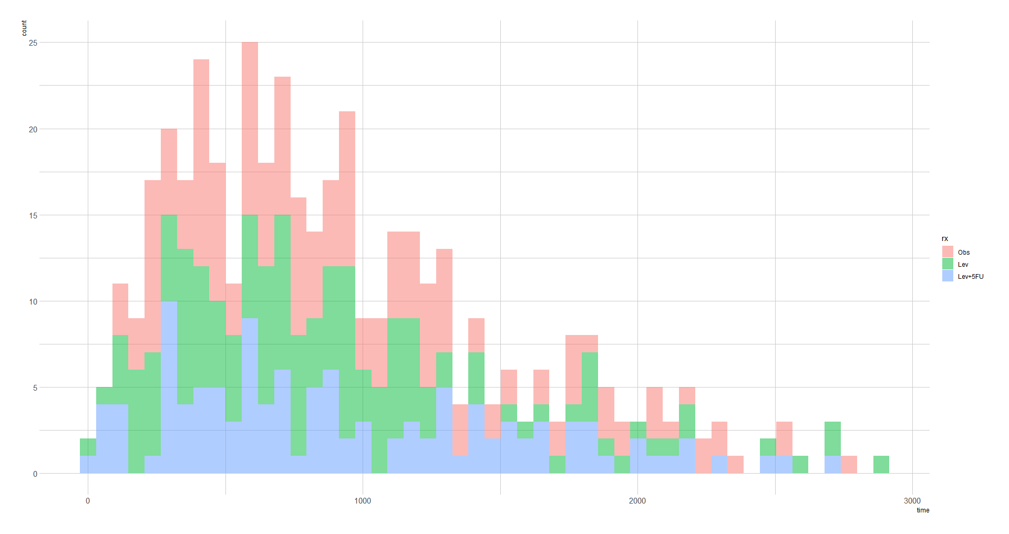
Define Questions & Explore Data
We can use the histogram to see the distribution of death time of three treatments. (Excluded the censoring data)
From this plot we can see the distributions of those treatments are roughly the same. Most of the patients died before 1000 days.

Slide 5
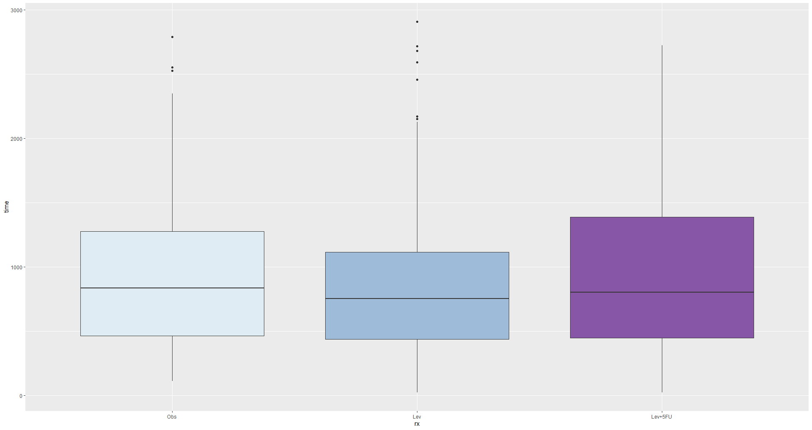
Define Questions & Explore Data
We can also use box plot to compare the death time of three treatments.(Excluded the censoring data)
By comparing the 50-th percentile of death time for each treatment, we can know that the 50-th percentile of death time for each treatment are roughly the same.
From the two plots, we may have a view that the survival probability may have no difference between those three treatments.

Slide 6
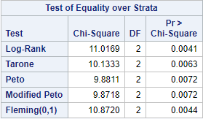
Log-Rank test
We need to use log-rank test to test if the hazard rates of those three treatments have difference.
From this table we can know that all of tests give a conclusion that the hazard rates are not the same in three different treatments under the significant level of 0.05.

Slide 7
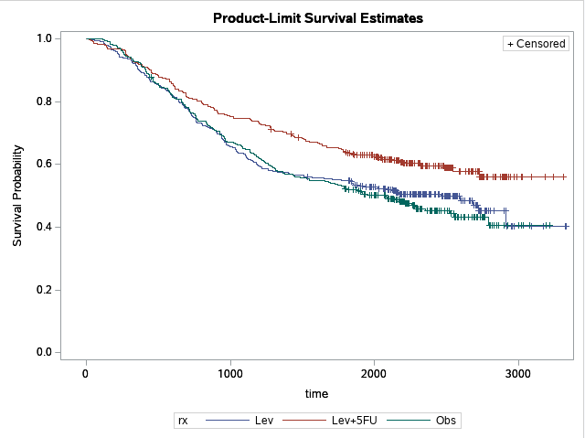
Test for Trend
We need to use trend test to tell us which treatment has the highest survival probability.
For giving a first glance, I drew the K-M survival curve for those three treatments.
From this K-M survival curve we can roughly know the survival probability of patients who received Levamisole+5-FU treatment is higher than the other two treatments.
The survival probabilities of Observation and Levamisole are roughly the same.

Slide 8
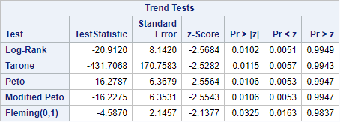
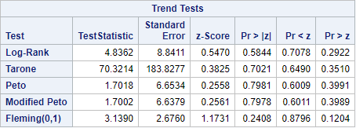
Test for Trend
Trend test for Levamisole+5-FU and Levamisole
We need to do two trend tests and apply Bonferroni correction for two tests.
From the top table, we can know there is a significant difference between the treatment of Levamisole+5-FU and Levamisole under the significant level of 0.05. Because there are only two samples compared in this trend test, the hazard rates of Levamisole+5-FU is strictly smaller than Levamisole.
From the bottom table, we can know that there is no difference between the treatment of Levamisole and Observation under the significant level of 0.05.
We can conclude that the patients treated with Levamisole+5-FU have the highest survival probability but the survival probabilities have no difference between the patients who received Levamisole or Observation treatment.
Trend test for Levamisole and Observation

Slide 9
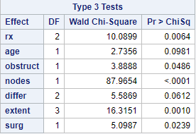
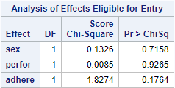
Cox-PH Regression Model: Model Selection
There are 10 covariates needed to select to participate in the model. 8 of the variables are category variables and 2(age, nodes) of them are continuous variables.
I used forward selection and set the entry P-Value as 0.1.
Finally, there were 7 variables entered into the model and 3 were excluded.

Slide 10
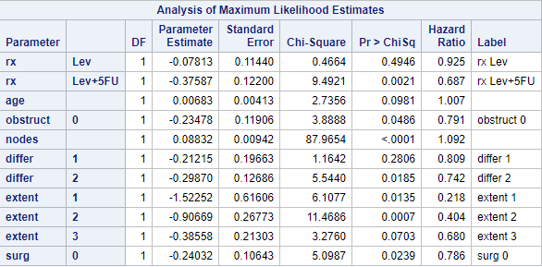
Cox-PH Regression Model: Model Interpretation
From the result we can know that there are only two variables that can increase the relative risk compared with the baseline. The two variables are age and nodes respectively.
The other variables can decrease the relative risk compared with the baseline.
For the variables which do not include in the model, we can say the effect of those variables are roughly the same.
The Cox-PH model also give a evidence that Levamisole+5-FU has the highest survival probability compared with Levamisole or observation.

Slide 11
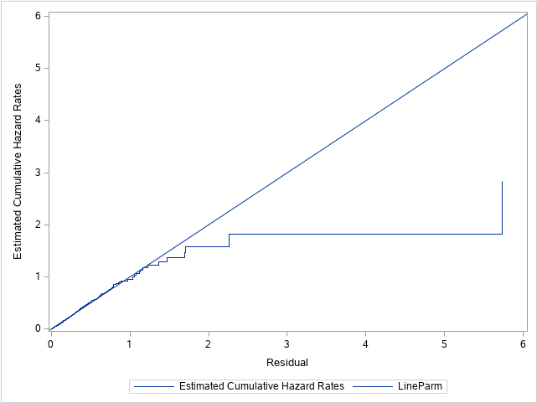
Cox-PH Regression Model: Model Diagnostics
First, we should check the overall fitting of the model by using Cox-Snell residuals.
The model does not fit the data very well.

Slide 12
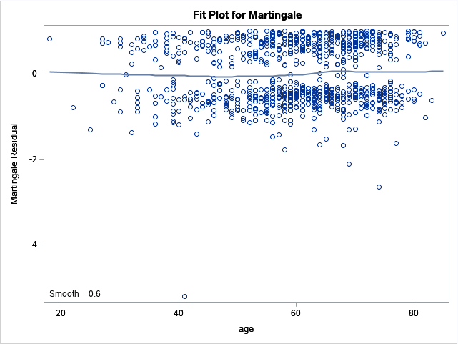
Cox-PH Regression Model: Model Diagnostics
Second, we need to use Martingale residuals to check non-linearity of continuous variables.
Age:
From this plot we can know that the age in this Cox-PH model is linear.

Slide 13
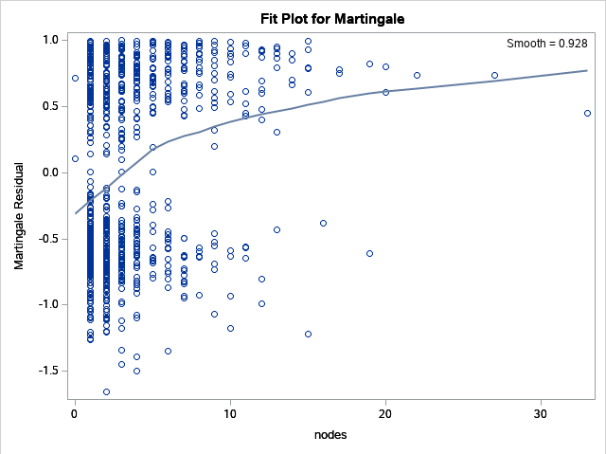
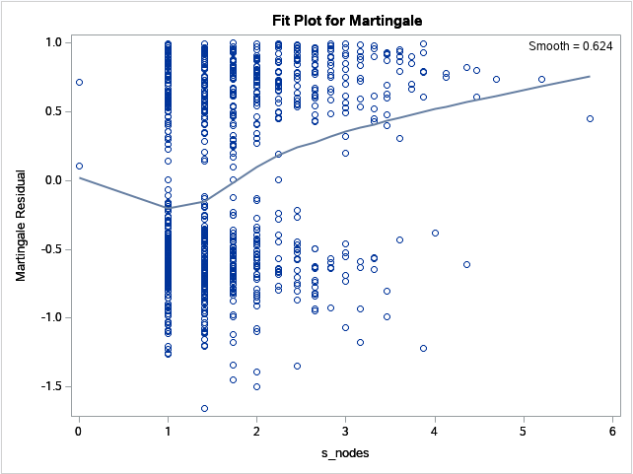
Cox-PH Regression Model: Model Diagnostics
Nodes variable:
From the top plot, we can know the nodes variable is non-linear. We should do a square root operation for the nodes variable. Because the form of this line is very like the form of square root function.
After the square root operation, It is better than before. It is my subjective point of view. (Bottom plot)

Slide 14
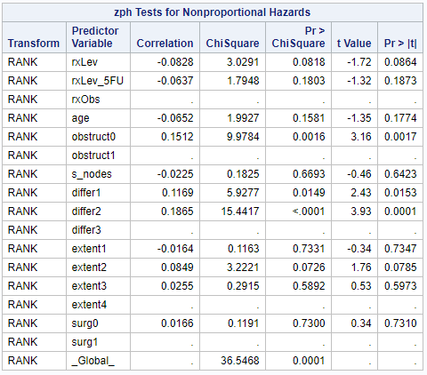
Cox-PH Regression Model: Model Diagnostics
Third, we can test correlation of Schoenfeld residuals against with time to show which covariates do not fit the PH assumptions.
From this table we can know the obstruct and differ do not fit the PH assumptions under the significant level of 0.05. We should remove them from our model.

Slide 15
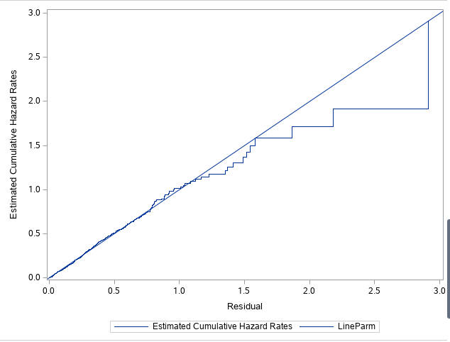
Cox-PH Regression Model: Model Diagnostics
After removing two variables and doing square root operation for the nodes variable, we can get a new model.
We can check the overall fitting of the new model by using Cox-Snell residuals.
From this plot we can know this new model fits the data much better than old model.

Slide 16
My point of view
If we want to interpret the variables, we should use the old model. Beause it contains more covariates.
If we want to do some preditions for a new patient, we should use the new model. Because it fits the data better then old.

